Slide 1

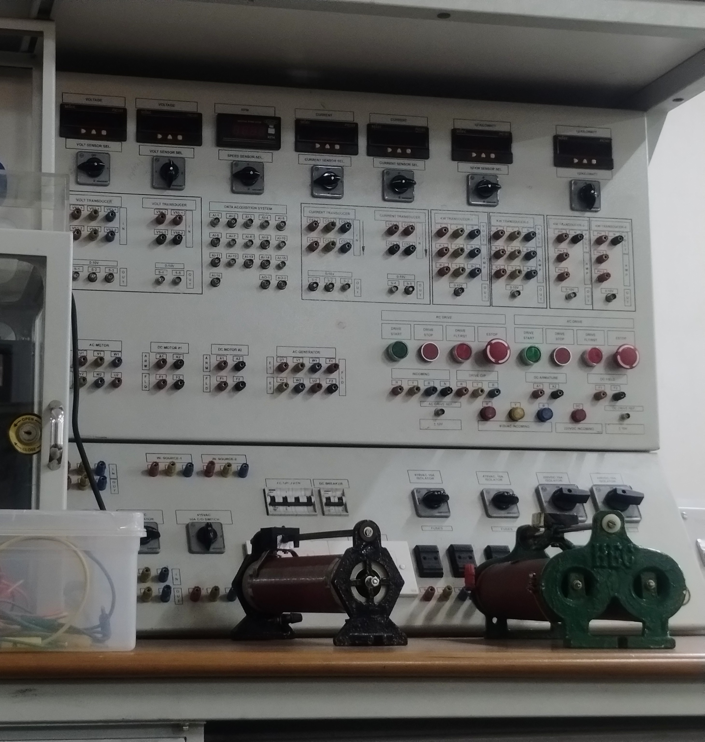
Automated Monitoring System for Machines lab
Enhancing lab efficiency, safety, and learning through real-time data.
By
Vijay Kumar Meena - 22BEE0348
Under the guidance of :
Prof. Sri Hari Mandava Associate Professor Sr. School of
Computer Science and Engineering

Slide 2
Contents
Introduction
Literature Review
Scope / Gaps
Objectives
Work done (if any)
Timeline & Milestones
Current status
Conclusion
References

Slide 3
Introduction: The problem statement
The DC/AC Machine Laboratory currently relies on manual systems for monitoring electrical parameters when students perform experiments. While functional, these systems present several challenges:
Time and efforts: Manual note taking for every experiment, since we currently are not using/ buying Labview licenses as per now.
Proprietary Software Costs: Reliance on expensive LabVIEW licenses creates a financial burden and limits accessibility for students and the college, is the reason we don't.
Limited Real-time Analysis: Current setups lack comprehensive real-time visualization and analysis capabilities, hindering immediate feedback for experiments.
Our proposed system addresses these issues by developing an open-source, cost-effective, and robust solution for real-time electrical machine monitoring.

Slide 4
Literature Review & Technical Gaps
Our initial review indicates several existing machine monitoring solutions, but most fall short for our specific lab environment due to cost, complexity, or lack of real-time capabilities.
Existing Approaches:
Identified Gaps:
Industrial PLCs/SCADA: Robust but expensive and complex for educational settings.
Cost-Effectiveness: Need a solution that is affordable and replicable without recurring software costs.
Proprietary DAQ Systems (e.g., LabVIEW): High license fees, limiting long-term sustainability.
Open-Source Adaptability: Requirements for customisation and integration with diverse lab setups.
Basic Microcontroller Projects: Often lack comprehensive data processing and user interface.
User-Friendly Interface: A system accessible to students with varying levels of programming experience.

Slide 5
From Proprietary Systems to an Open-Source Solution
1. Core Hardware Technologies:
Microcontrollers (Arduino/ESP32): Low-cost, open-source platforms with built-in Analog-to-Digital Converters (ADCs) that form the heart of modern DIY data acquisition systems.
We are starting with the Arduino for our prototype build which is our project goal for this semester, and further we will turn the prototype into a proper working embedded system for particular use case as the capstone project.
Voltage Sensing: Achieved safely using a resistive voltage divider to scale high machine voltages down to a microcontroller-safe range (0-5V).
Current Sensing: Implemented with non-invasive Hall Effect sensors (ACS712), which translate the magnetic field of a current into a proportional analog voltage.
2. The Software & Communication Stack:
Serial Protocol: The fundamental, reliable method for transmitting sensor data from the microcontroller to a host PC over USB.
Python Ecosystem: Chosen for its rapid development and powerful open-source libraries:
PySerial: For handling the low-level serial communication.
Matplotlib: For robust and customizable data visualization.
CustomTkinter: For building a standalone, cross-platform graphical user interface (GUI).

Slide 6
Project Scope & Objectives
Scope
Objectives
Develop a real-time monitoring system for electrical parameters (current, voltage, power) of electrical machines/workbenches in the DC/AC Machine Lab. The system will comprise:
1
Implement open-source hardware & software
Reduce reliance on proprietary solutions and lower operational costs.
Microcontroller-based data acquisition.
Python-based desktop interface for data display.
2
Enable real-time data capture
Numerical and graphical visualization.
Accurate and immediate acquisition of electrical parameters from machines.
3
Provide intuitive data visualization
Enhance user understanding through clear numerical and graphical displays.
4
Improve lab safety & learning
Offer better insights into machine performance and facilitate experimentation.

Slide 7
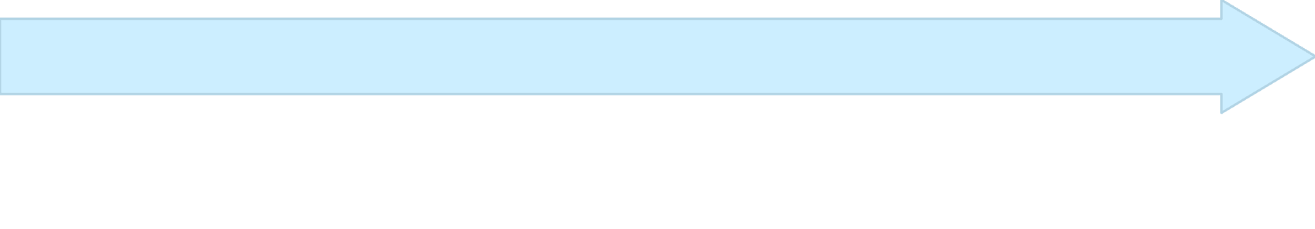
Prototype Development: Phase 1 & 2 Progress
We are currently in the initial stages of prototype development, focusing on establishing core data acquisition and basic visualization.
Phase 2: Python Data Processing & Graphing
Phase 1: Hardware Integration & Data Logging
Objective: Develop Python scripts to load raw data, perform calculations (e.g., power), and generate various real-time graphs.
Objective: Collect raw electrical parameters (voltage, current) from a basic circuit (battery, LEDs, breadboard) using a microcontroller and log to an Excel file.
Data Import: Python script successfully reads data from Excel files.
Microcontroller Choice: Initial prototype will use Arduino Uno for its ease of use and immediate availability. Subsequent phases will transition to ESP32 for enhanced capabilities.
Parameter Calculation: Power calculation implemented ($P = V \times I$).
Graphing Modules: Utilising Matplotlib/Seaborn for visualising Voltage vs. Current, Power vs. Time, etc.
Sensor Interfacing: Successful integration of current and voltage sensors.
Data Validation: Preliminary checks to ensure data integrity and consistency.
Code Development: Firmware written for data acquisition and serial communication.
Data Export: Data streamed to PC and saved into a CSV/Excel format.

Slide 8
Next Steps: Phase 3 & Beyond
With the core data acquisition and plotting capabilities established, the next phase focuses on refining the user experience and preparing for full lab integration.
1
2
Phase 3: Graphical User Interface (GUI) Development
Future Considerations: App vs. Web Interface
For lab environment: A dedicated desktop application (as in Phase 3) is ideal due to potentially limited internet access and direct hardware interaction.
Objective: Create an intuitive and user-friendly desktop application for real-time monitoring and analysis.
Framework: Investigate suitable Python GUI frameworks (e.g., PyQt, Tkinter, Kivy) for cross-platform compatibility.
For wider accessibility: A web-based interface could be explored in a later stage, potentially using Flask/Django for backend and React/Vue for frontend, but this would require a dedicated lab server.
Features: Real-time numerical display, interactive graphs, data logging controls, and experiment management.
Deployment: Package the application for easy installation on Windows machines in the lab.

Slide 9
Timeline & Milestones
Our project is structured into clear phases with defined deliverables to ensure timely completion and effective resource management.
Month 1-2
Next - Capstone project
Project planning & literature review
Phase 3 completion: Full GUI development
Component procurement (Arduino, sensors)
System testing & debugging with lab machines
Phase 1 completion: Data acquisition to Excel
Documentation & user manual preparation
Month 3-4
Phase 2 completion: Python graphing & calculations
Arduino integration tests
GUI framework selection & basic UI wireframing
We are staying in touch with our project faculty and resolving hurdles and problems if any to meet the milestones at the required timeline or earlier

Slide 10


Current Status & Future Impact
Current Status
Anticipated Impact
Cost Savings: Eliminates expensive software licenses.
✅ Data Acquisition & Basic Plotting Operational We have successfully demonstrated data logging from simple circuits and can generate preliminary graphs using Python. This validates the core technical approach.
Enhanced Learning: Provides students with real-time feedback and hands-on experience with data analysis.
Improved Safety: Enables continuous monitoring of machine parameters, potentially preventing overloads.
Research Opportunities: The open-source nature allows for future expansion and customisation for advanced research.
Further : We need to make power calculations, different options for graphing the values that we have got and then further update the GUI accordingly, and then move to procurement of ESP32 boards, which will enable more robust data handling, Wi-Fi capabilities, and direct integration with lab workbenches.

Slide 11
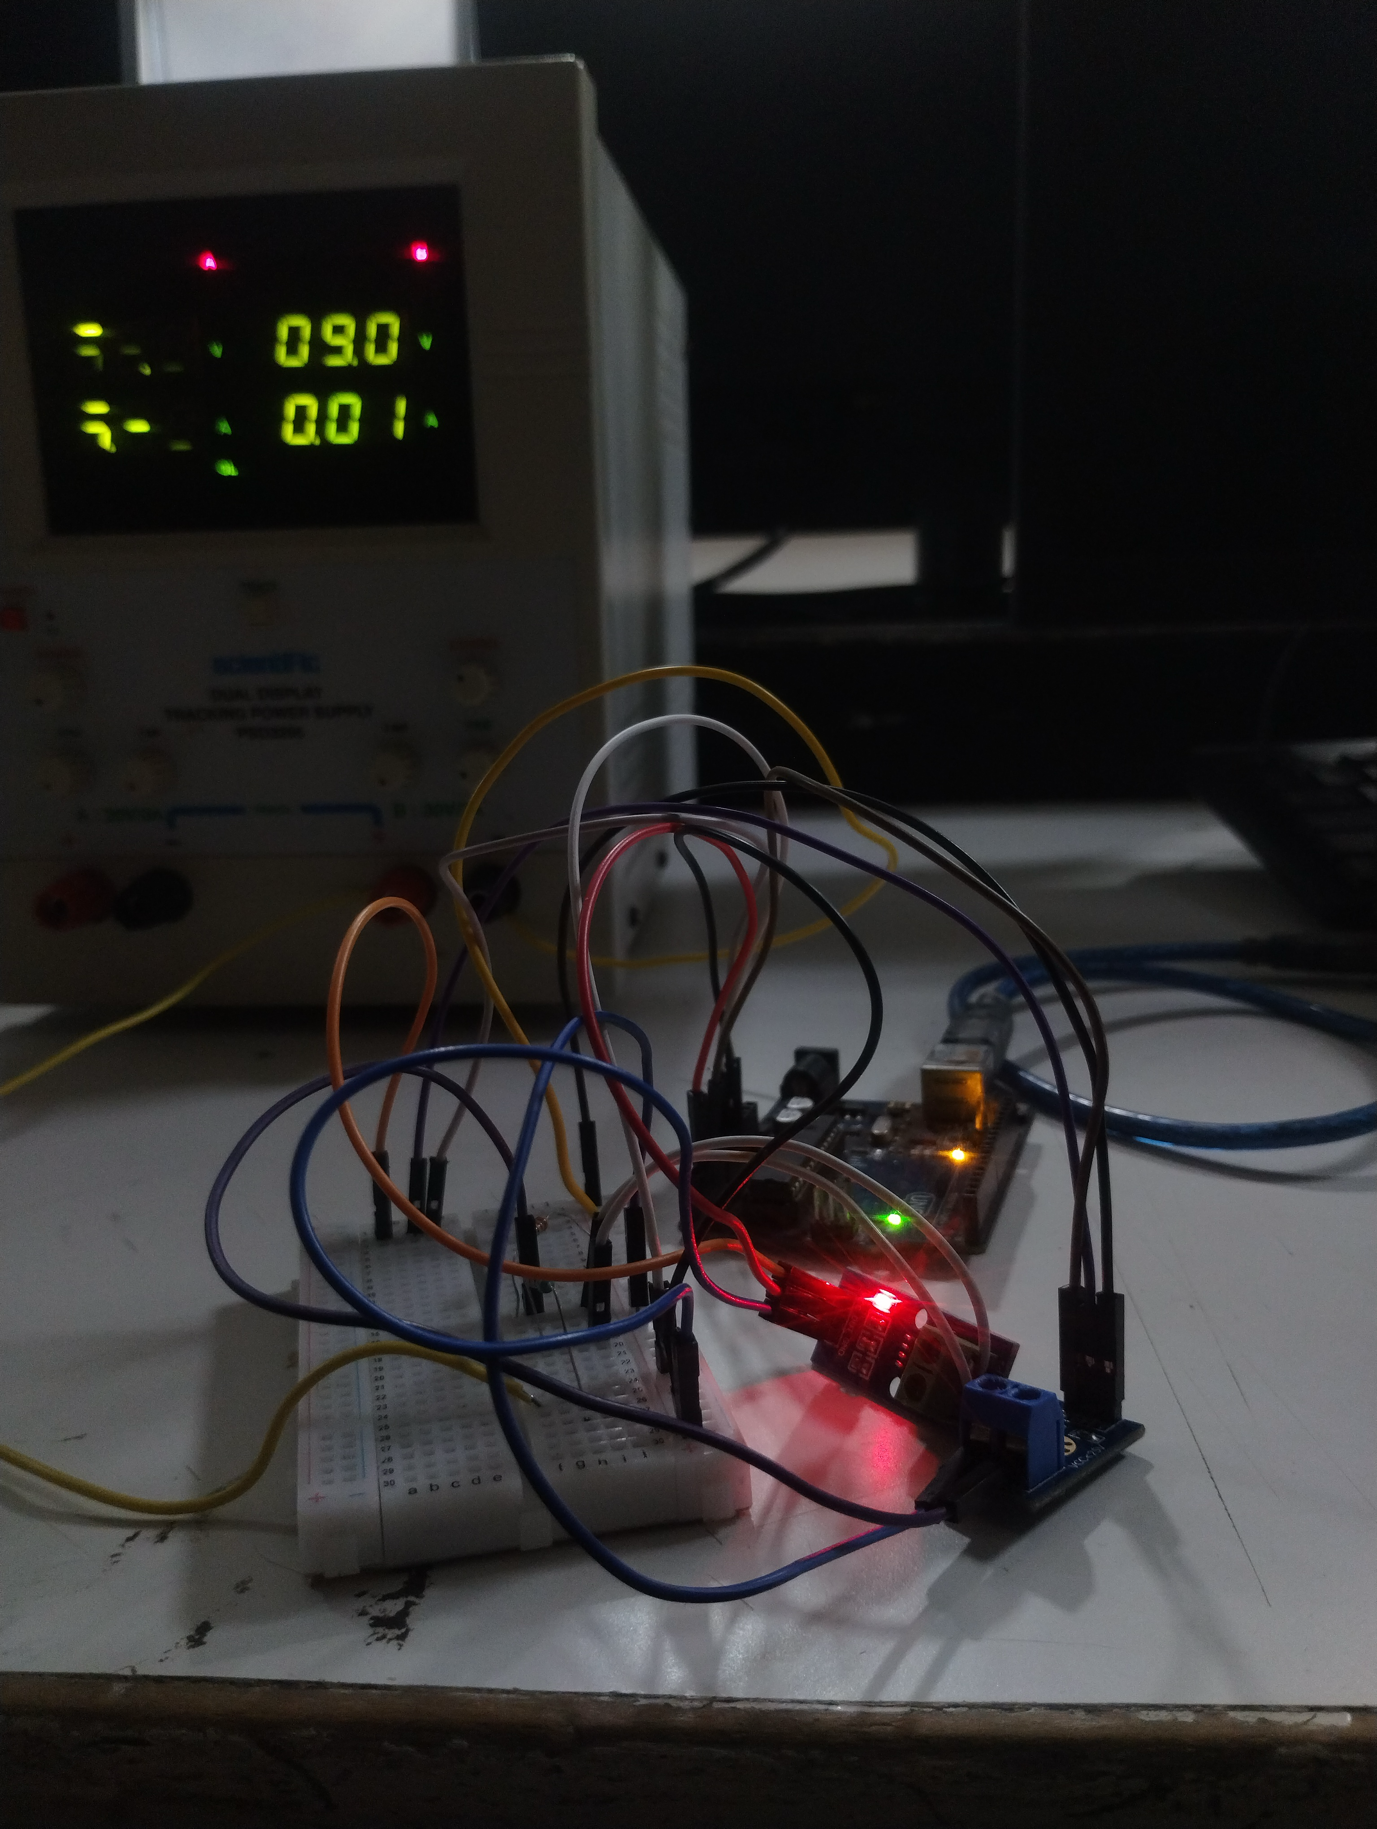
Current Status (continued)
So this is how our prototype looks like, we have used the following
DC Voltage Source
Arduino
Some Connecting Wires
Breadboard
Arduino Code
Python gui
Voltage Sensor
Current Sensor
We have a functional data acquisition circuit has been built
using an Arduino Uno and a voltage sensor.
A user-friendly desktop application has been developed in
Python with an interactive interface for experiment control.

Slide 12
Conclusion & References
The automated monitoring system project promises a significant upgrade to the DC/AC Machine Laboratory, providing a modern, cost-effective, and educational tool for future engineering students.
Key Takeaways:
Open-source solution for cost-efficiency.
Real-time data for enhanced insights.
Modular design for future expansion.
References :
Smith, J. (2019). Microcontroller-Based Data Acquisition Systems. Electrical Engineering Press.
Python Software Foundation. (2023). Python Documentation. Available at: www.python.org
NumPy Developers. (2023). NumPy User Guide. Available at: numpy.org
Hunter, J. D. (2007). Matplotlib: A 2D Graphics Environment. Computing in Science & Engineering, 9(3), 90-95.

